Slide 1
ELDER CARE MANAGEMENT SYSTEM
TS- WEB/CC/AI TRACK CAPSTONE PROJECT
Presented By:
1. Miss Karumuru Madhavi – IIIT RK-VALLEY (Btech ECE)
2. Miss Peddapothula Gowri Varalakshmi-IIIT RK-VALLEY (Btech CSE)
Guided By: Poovaragavan Velumani

Slide 2
OUTLINE
Abstract
Problem Statement (Should not include solution)
Aims , Objective & Proposed System/Solution
Analysis and Design
System Development Approach(Technology Used)
Algorithm & Deployment
Conclusion
References
Future Scope

Slide 3
Abstract
Our project is about the website which gives data about every old age home and we manage every old age home through a single website
In this project, we have developed a website which can handle multiple old age homes. This website contains five major sections, those are, the admin, the vacancy check, the donation, the volunteer and the media. Admin page is for the one who take care of the old age home, this admin performs all the functions like adding old age home person data, removing person data etc. The vacancy check page is useful for users to get the data related to every old age home. Through donation section people can donate the money to the organizations. People who want to work as a volunteer can contact us through this component. And finally media section displays the all the activities performed through this website.

Slide 4
Problem Statement
The main purpose of Elder Care Management System provides all the data about multiple old age homes
and multiple old age homes can be managed through this single website. This system helps admin to
manage data of old aged persons in an efficient way. This system reduces the saves people time by
providing every home data at one website otherwise people has to spend a lot of time for choosing the
old age home.
The system will maintain location wise old age home details of particular region. The system will also
provides the rating given the people for that old age home based on the rating people can select old
age home. The system will provide list of old age homes to choose the perfect one.

Slide 5
Proposed Solution
Their proposed solution is based on a set of technologies that comprises a monitoring sub-
system for screening and follow-up, a digitalized older adult care model, and a virtual assistant
for the delivery of preventive, therapeutic, and educational interventions.

Slide 6
Analysis
Now a days homeless old age persons are increasing rapidly, due to the rapid developement in technology everything is available in online mode. Even though there are multiple number of old age homes, still may people doesn’t know about its location, joining process etc. There is no website which can handle muitple old age homes. To solve this problem we came up “ELDER CARE MANAGEMENT SYSTEM” . It provides a data about multiple old age homes at one webiste. This website helps to manage the mutiple number of old age homes through a single website. In this website user can check the old age home details present in the vacancy check page, user can select the perfect old age home according to location,needs and activities. In this website for every home, there is an admin who manages all the data related to that old age home. The updataion,deletion and insertion of citizems data can be done. This system will be helpful for the users to select the old age home as soon as possible. And we can handle multiple old age homes. In this system there is a an option to donate,these donation data maintanins by admin. And out online system provides a chance for users to work as volunteers, people can work as a volunteer by selecting the form, through volunteer section we can peeform many more useful tasks like food drive, fund raising, plantation, etc. In this way our online system saves user time and can handle old age homes effectively

Slide 7
Design
Design is the place where quality is fostered in development. Software design is a process
through which requirements are translated into a representation of software. Software design
is conducted in two steps. Preliminary design is concerned with the transformation of requirem
ents into data. The design activities are of main importance in this phase, because in this activity,
decisions ultimately affecting the success of the software implementation and its ease of
maintenance are made. These decisions have the final bearing upon reliability and maintainability
of the system. Design is the only way to accurately translate the customer’s requirements into finished software or a system.

Slide 8
System Deployment Approach
Software requirements:-
Front End - HTML, CSS, Java Script, Jquery , Mysql , PHP
Web Browser - Firefox , Google Chrome or any compatible browser
Operating System – Ubuntu , Windows or any equivalent OS
Technology - Web Development
Hardware requirements:-
Ram - 512 MB
Hard disk - 10 GB
Processor - 1.0 GHz

Slide 9
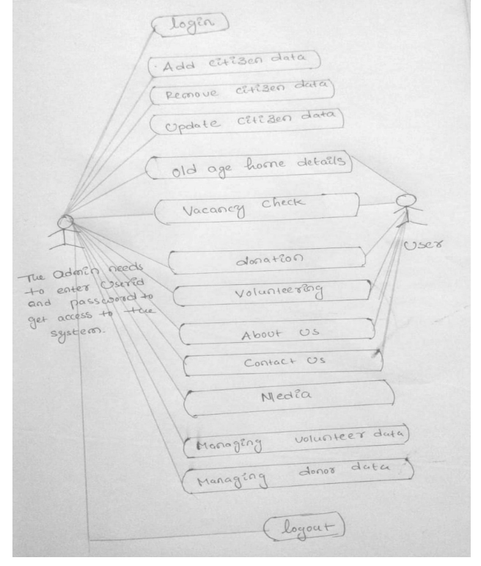
Algorithm & Deployment

Slide 10
The description of set of sequence of actions. Graphically it is rendered as an ellipse with solid line including only its name. Use case diagram is a behavioural diagram that shows a set of use cases and actors and their relationship. It is an association between the use cases and actors. An actor represents a real-world object. Primary Actor – Sender, Secondary Actor, Receiver.

Slide 11
CONCLUSION
The development of Elder Care Management System involved many phases. We have used the top-down approach, in this approach, first we concentrate on first level and moving to successive levels. The first phase started with a detailed study of the problems. This system is efficient in maintaining old age home details, multiple old age homes can be maintained through single software. It provides all the old age homes data at one place and saves users time.

Slide 12
REFERENCES
FOR HTML : https://www.w3schools.com/html/html_intro.asp
https://www.geeksforgeeks.org/html/
FOR CSS : https://www.w3schools.com/css/css_intro.asp https://www.tutorialspoint.com/css/index.htm
For Javascript: https://www.w3schools.com/js/js_intro.asp
https:/ /www.javatpoint.com/javascript-tutorial
For Jquery: https://www.tutorialspoint.com/jquery/index.html https://www.w3schools.com/jquery/
For PHP: https://www.javatpoint.com/php-tutorial
https://www.geeksforgeeks.org/php-tutorials/
For Mysql: https://www.w3schools.com/MySQL/default.as

Slide 13
THANK YOU

